Slide 1
August 11, 2021

Slide 2
Agenda
Discussion with ESD Commissioner Cami Feek
UI Program Update
UI Rulemaking Update
SB 5193 Implementation

Slide 3
Discussion with Commissioner Feek
August 11, 2021
Cami Feek, Commissioner
Employment Security Department

Slide 4
UI Program Update
Unemployment Insurance Advisory Committee Presentation
August 11, 2021
Joy Adams, UI Quality Assurance and Operations Manager
Scott Michael, Legal Services Manager
Employment Security Department

Slide 5
UI Program Updates
Work Search Reinstatement
In July, claimants resumed reporting work search activity on their weekly claim.
96% of claimants are reporting job search activities weekly.
Job search activities posted on 16 language landing pages, in addition to return to work and refusal of work content.
Job search pages account for 11% of total downloads from the language landing pages since July 12th.
Potential New Claims
Re-launched regular reviews for new claim eligibility June 11th.
105,000 claimants asked to respond to questionnaire; over 86,000 have responded to date.
Outreach continues to connect remaining claimants with claims agents.
We are approaching the time when issues will be set for claimants who have not responded.

Slide 6
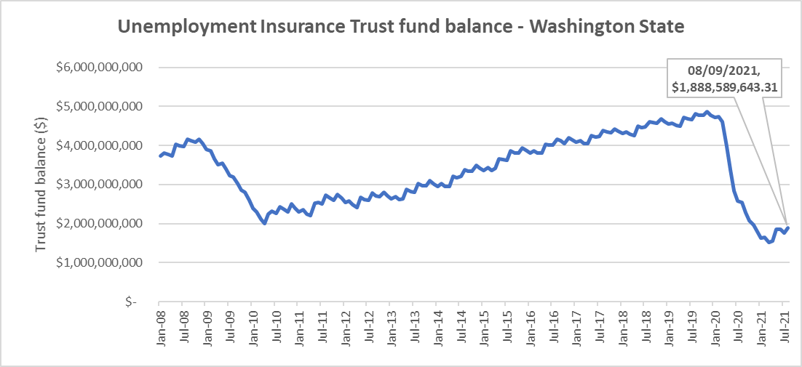
Unemployment Insurance Trust fund
On August 9th, the UI trust fund balance was $1.89 billion

Slide 7
Months of Benefits Calculation (08/09/21)
Trust Fund Balance: $1.89 billion
Total Wages: $196 billion
Reserve Ratio (RR): $\left(\frac{\$1.89billion}{\$196 billion}\right)\text{∗}100=\text{0.96 }$
Average High-Cost Rate (AHCR): 2.44
Months of Benefits: $\left(\frac{0.96}{2.44}\right)\text{∗}12=4.74 Months of Benefits$

Slide 8
CARES Act Program Expiration
The week ending September 4, 2021 is the last week for which a person can claim the following federal benefits:
PUA (Benefits for those who do not qualify for regular unemployment)
PEUC (Extra weeks of benefit when regular claim expires)
FPUC (Bonus $300 added on to weekly benefit checks)
Payments for these benefits can occur after September 4, 2021 when:
Claim is allowed to be backdated
Payment is held while an issue is adjudicated
A denial of benefits is overturned on appeal
Last day to file an initial application for PUA is October 6, 2021

Slide 9
CARES Act Program Expiration
Some Numbers
246,500 individuals have claimed at least one week of PUA or PEUC for the week ending July 1, 2021 or after
25,700 of these individuals have a different, active claim for regular unemployment benefits
15,800 of these individuals have 680 hours in a base year or alternate base year if they applied for benefits in 3rd quarter 2021, making them potentially eligible for a new regular unemployment claim
205,000 individuals who will most likely run out of state and federal unemployment benefits after September 4, 2021

Slide 10
CARES Act Program Expiration
Gender of PUA/PEUC Claimants Most Likely to Run Out of Benefits

Slide 11
CARES Act Program Expiration
Languages and Ages of PUA/PEUC Claimants Most Likely To Run Out of Benefits
Language Preference | % of Total
English | 95%
Spanish | 1%
Vietnamese | 1%
Traditional Chinese | 1%
Other | 1%
Korean | <1%
Russian | <1%
Cambodian | <1%
Laotian | <1%
Somali | <1%
Age Range | % of Total
<30 | 17%
30-45 | 38%
46-60 | 27%
>60 | 17%

Slide 12
CARES Act Program Expiration
Race of PUA/PEUC Claimants Most Likely to Run Out of Benefits

Slide 13
CARES Act Program Expiration
September 4, 2021 is also the last week for which:
Claimants do not have to serve an unpaid waiting week
The first week of benefits is federally funded and not charged to employers
Shared work benefits are federally funded and not charged to employers
Reimbursable employers get a 75% reduction in their benefit charges
If the payment is made after September 4, 2021, employers will still see benefit charge relief, so long as the benefits are paid for the week of unemployment ending September 4, 2021

Slide 14
Communicating about end of CARES Act
Communications Plan
Program end dates will be posted on our website.
Between now and Sept. 4, we will start messaging impacted groups of claimants.
Our communications campaign to claimants and employers also will include:
Updating letters as needed
Information in employer newsletter
Website content
Social media
Banner in eServices
FAQs
Phone hold message
Media outreach, including Spanish language radio

Slide 15
Rulemaking and Legislative Update
Unemployment Insurance Advisory Committee Presentation
August 11, 2021
Scott Michael, Legal Services Manager
Employment Security Department

Slide 16
Agency Request Legislation
Cross Reference Corrections
RCW 50.29.025(1)(c)(ii) – “The social cost factor rate [for delinquent employers] shall be the social cost factor rate assigned to rate class 40 under (b)(ii)(A) of this subsection.”
Subsection (b)(ii)(A) points precisely to the social cost factor rate of employers assigned to Rate Class 1, not Rate Class 40.
Cross reference should be subsection (b)(ii), the general list of social cost factor rates for all rate classes
RCW 50.29.070(1) – “The [tax rate] notice must include the amount of the contribution rate that is attributable to each component of the rate under RCW 50.29.025(2).”
Subsection (2) of RCW 50.29.025 was moved to subsection (1) by SB 5061 (2021)
Cross reference should be RCW 50.29.025(1), where the components of employer tax rates are specified

Slide 17
Agency Request Legislation
Using Inclusive Language
Replacing the term “alien” with “noncitizen”
Removing “the relationship of master and servant as known to the common law” with “any employment relationship known to the common law” from the definition of “Employment”
Includes provision that the bill is not intended to increase or reduce the scope of the definition of “Employment”

Slide 18
Rulemaking Update
Hours of Availability
Adopted permanent rules stating claimants only need to be available for up to 40 hours per week that are customary for their occupation.
Current rules say claimants need to be available for all hours customary for their occupation
New rules are effective January 2, 2022

Slide 19
SB 5193 Implementation
Unemployment Insurance Advisory Committee Presentation
August 11, 2021
Julie Lord, UI Customer Support Director
Jill Will, UICS Policy and Legislation Implementation Manager
Employment Security Department

Slide 20
SB 5193 Implementation
ESSB 5193 Sec. 3 (3) requires ESD to work with the UIAC to explore:
Establishing thresholds that will trigger automatic adjustments in ESD staffing assignments and phone agent staffing levels;
Establishing a pilot to provide a caseworker approach to the claims of a group of claimants with that casework carrying over to reemployment services;
Increasing language access, including by providing translation of notices sent to claimants as part of their unemployment insurance claims; and
The frequency of the initial and continuing training to maintain a reserve force of skilled adjudicators who can be available quickly when claims volume demands.

Slide 21
SB 5193 Implementation
ESSB 5193 UI Systems Enhancements
Multiple major requirements – split into five projects to get the work done
Quarterly report to the Legislature, first report due September 1
Implementation of ESSB 5193
Performance metrics
Any new federal programs
Any software or technology issues related to claims processing
Updates on protocols and processes for sensitive data
Annual report on Adjudicator Pool due October 1

Slide 22
SB 5193 Implementation
#1 – Letters Project
Revise all determination and redetermination letters and plain-talk all UI correspondence directly related to a specific claimant’s case
In process with cross-agency Research and Writing Teams
Determination and redetermination letter template
Monetary determination letter
Identity issue fact finding letter
Reevaluate claim letter

Slide 23
SB 5193 Implementation
#2 – Online Data Dashboard Project
Create online data dashboard and provide quarterly written data report on specific performance metrics. Additional metrics added at request of JLARC.
In process with LMEA and UICS Data Teams
Draft dashboard elements established
Dashboard under development
Gathering quarterly report data definitions, elements, data sources

Slide 24
SB 5193 Implementation
#3 – Dedicated Phone Lines Project
Establish dedicated toll-free phone lines to allow access for claimants who: lack computer skills, lack access to computers, have disabilities, have limited English proficiency
Existing 800 line to request accommodation for disabilities will remain in use
Phone access for those lacking computer access still under review
In process with Automated Voice and Data, UICS, Customer Experience, Communications, Vendor
Establishing a new 800 line for LEP claimants
LEP scripts, phone menu, prompts for top 25 languages
Updated instructions for LEP claimants on accessing service

Slide 25
SB 5193 Implementation
#4 – Reserve UI Adjudicator Pool Project
Establish a training program and form pool of trained reserves who could serve as UI claims adjudicators in the event of future large spikes in unemployment. Submit annual project status report on number trained.
Draft training plan presented
Curricula includes NASWA Adjudicators Certification and Customer Service online followed by one week of UI training and one week of UTAB system training
Pilot program began July 21, 2021 with a class of 25 new Interns – proof of concept

Slide 26
SB 5193 Implementation
#4 – Reserve UI Adjudicator Pool Project (con’t)
In process with UICS Training Team, HR, Contracts
Schedule will outline the project to mid-2022
Work with union on required notifications
Draft interagency agreement
Capture NASWA and UICS training in Learning Management System

Slide 27
SB 5193 Implementation
#5 – Advisory Committee Project
Work with advisory committee to explore
thresholds for triggers to adjust staff for assignments and phones
creating a pilot for having caseworkers work with claimants on their claims and reemployment services
identifying next steps for translating written UI materials into other languages

Slide 28
SB 5193 Implementation
#5 – Advisory Committee Project (con’t)
In process with Government Affairs, Customer Experience, and Equal Opportunity Office
Recruiting for subcommittee members to provide input on translation of UI materials
Gathering background information on language utilization and current LEP services
Documenting high level process for claimant experience through the UI system and on to job placement services
Gathering background information on potential triggers
Target - Feedback sessions to start in September

Slide 29
Closing
Next Agenda - discussion
Public Comment
Adjournment

