Slide 1
January 27, 2023

Slide 2
Agenda
Approval of Meeting Schedule
June Trust Fund Report
Updated Taxable Wage Base
Rulemaking Update
Legislative Proposals
Overpayment updates

Slide 3
June Trust Fund Reports
Vaughn Ellis, Office of Actuarial Services, ESD

Slide 4
September UI Trust Fund Report
The June 2023 report provides the status and updated projections of the state’s unemployment insurance (UI) trust fund for 2022 through 2027.
The report is based upon the June 2023 economic forecast released by the state’s Economic and Revenue Forecast Council (ERFC).
The report uses quarterly forecast information and UI tax and benefit data through March (Q1 2023).

Slide 5
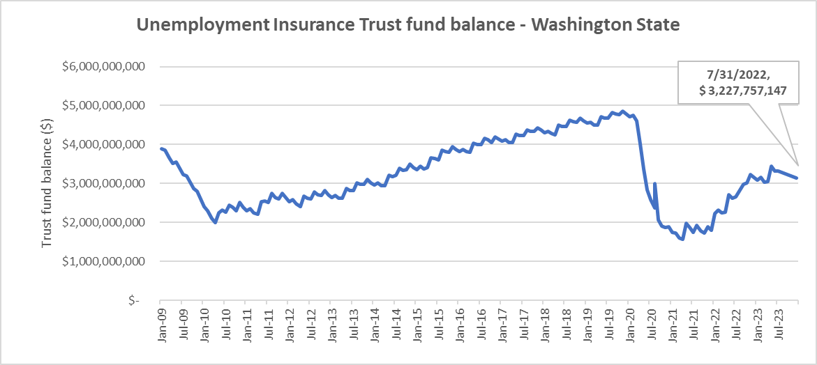
Unemployment Insurance Trust fund
On July 31st, 2023, the UI trust fund balance was approximately $3.2 billion

Slide 6
June UI Trust Fund Report: Key Takeaways
The unemployment trust fund balance is on a positive trajectory through 2027.
The projected trust fund balance for 2023 is roughly $3.8 billion, with 8 months of benefits projected for September 30th 2023.
The average projected tax rate for 2023 is 1.43%.
Total benefit payments for 2023 are projected at roughly $1.4 billion, equivalent to 2.1 million weekly payments.

Slide 7
UI Trust Fund Forecast (September 2022)
 | Sept 2022 Forecast | June 2023 Forecast
2023 Unemployment Benefit payment projection | $1.3 Billion | $1.4 Billion
2024 Unemployment Benefit payment projection | $1.6 Billion | $1.6 Billion
2023 Employer Contributions | $1.8 Billion | $1.9 Billion
2024 Employer Contributions | $1.9 Billion | $1.9 Billion

Slide 8
Benefit Payments
The average annual wage is used to calculate unemployment benefit levels for the year (July-June).
The minimum weekly unemployment benefit, calculated per state statute at 20 percent of the average weekly wage, is $323 for new claims opened on or after July 2th.
The maximum weekly benefit, which is the greater of $496 or 63 percent of the average weekly wage, is $1019.
Benefit Payment Amounts
Year: | CY 2021 | CY 2022 | CY 2023 | CY 2024 | CY 2025 | CY 2026 | CY 2027
Amount (in billions): | $1.6 | $1.0 | $1.4 | $1.6 | $1.6 | $1.7 | $1.6

Slide 9
Experience Tax Rate
The experience rate tax is an annual calculation based on the ratio of benefit claims charged to the employer and “taxable wages” reported by the employer over the preceding four fiscal years.
Per state statute, the taxable wage base is $67,600 in 2023.
Average Experience Tax Rates
CY 2021 | CY 2022 | CY 2023 | CY 2024 | CY 2025 | CY 2026 | CY 2027
1.23% | 0.92% | 1.00% | 1.00% | 0.90% | 0.77% | 0.75%

Slide 10
Social Tax Rate
The “flat social tax” is an annual tax calculation made after September 30 subtracting total experience rated taxes paid by all employers over four consecutive quarters from total unemployment benefits paid to all claimants over those same quarters.
This amount is then divided by total taxable payrolls and expressed as a percent.
Projected Flat Social Tax Rates
CY 2021 | CY 2022 | CY 2023 | CY 2024 | CY 2025 | CY 2026 | CY 2027
0.50% | 0.50% | 0.60% | 0.60% | 0.60% | 0.60% | 0.50%

Slide 11
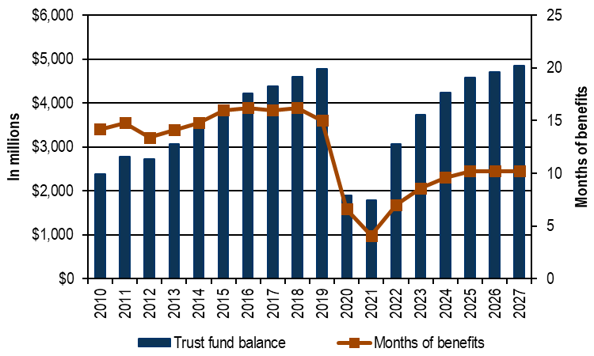
Projected Trust Fund Balances
Year | CY 2021 | CY 2022 | CY 2023 | CY 2024 | CY 2025 | CY 2026 | CY 2027
Amount (in billions): | $ 1.8 | $ 3.1 | $ 3.8 | $ 4.4 | $ 4.8 | $ 5.1 | $ 5.3

Slide 12
Updates Taxable Wage Base
Vaughn Ellis, Office of Actuarial Services, ESD

Slide 13
Taxable Wage Base
Beginning January 1, 2024, employers will pay unemployment taxes on the first $68,500 paid to each employee.
This value is calculated as 115% of last year's taxable wage base, capped at 80% of 2022 average annual wage for contribution purposes.
Year | Taxable Wage Base
2020 | $52,700
2021 | $56,500
2022 | $62,500
2023 | $67,600
2024 | $68,500
Notes:
Beginning January 1, 2024, employers will pay unemployment taxes on the first $68,500 paid to each employee. The calculation is as follows based on an AAW for contributions purposes in 2022 of $85,667:
· Round down (115% times $67,600) = $77,700 which exceeds the 80 percent maximum
· Round down (80% times $85,667) = $68,500

Slide 14
Rulemaking & legislative Implementation Update
Scott E. Michael, Legal Services Manager, ESPI, ESD
Caitlyn Jekel, Government Relations Director, ESD

Slide 15
Rulemaking
Recent Past
Overpayment Waivers – extended emergency rules to October 25, 2023
Expanded Voluntary Quits (HB 1106) – shared draft rules proposing a definition of “family member” consistent with PFML definitions
Transportation Network Companies (HB 1570) – shared draft rules proposing that “hours worked” for purposes of driving for a TNC should be reported as “passenger platform time” doubled
SOC Code Reporting for Tribes (HB 1684) – shared draft rules allowing tribes to report or not report SOC Codes or job titles on their quarterly reports as they see fit

Slide 16
Rulemaking
Recent Past
Public Records Procedures – shared draft rules allowing persons making public records requests to ask for an internal agency review of the response to their public records requests
Failure to Respond – officially proposed rules setting a possible end date on when someone is denied benefits due to a failure to respond. Hearing is August 10, 2023
Public Health Emergencies – completed rulemaking for when a public health emergency begins and ends mid-week

Slide 17
Rulemaking
Near Future
Overpayment Waivers – expect to see draft permanent rule proposals
Conditional Payments – expect proposed rules defining when a conditional payment of benefits begins and ends
Transportation Network Companies (HB 1570) – workgroup is discussing possible rules related to relief of charges for part-time employers, quits due to workplace safety, quits due to 25% or more reduction in hours or compensation

Slide 18
Implementation
Transportation Network Company (HB 1570)
Workgroup proposes to add this to the list of approved job search activities on the ESD website:
Approved job search activity | Documentation ideas
Take steps to set up a new account, or activate one you already have, on app-based work platforms (for example: Uber, Lyft, Doordash, Instacart, or other). | Screenshot or picture of the renewal of required license Screenshot or picture of completed onboarding document requirements on app-based platform Copy of completed vehicle inspection Screenshot of contact with an app-based platform for support in onboarding or activating an account
Other activities to demonstrate ongoing and active efforts to work on app-based platforms (for example: Uber, Lyft, Doordash, Instacart, or other). | Screenshots demonstrating ongoing and active efforts to log-in to app-based platforms and be available for work

Slide 19
Implementation
Apprenticeship Workgroup (SHB 1458)
ESD held an initial convening with Registered Apprenticeship representatives
Demonstration and listening session: Mid August
1:1 claimant interviews with 15-20 apprentices
Soliciting employer feedback
Report draft to be complete 10/8, due to the legislature 12/1

Slide 20
break
10 - min break

Slide 21
2024 Legislative Proposals
Caitlyn Jekel, Government Relations Director, ESD

Slide 22
2024 legislative proposals: UI
Relief of Benefit Charges | RCW 50.29.021 | Proposal to split the list of reasons an employer is able to receive relief of benefit charges into three categories: Relief that can be given automatically because ESD already has all the information it needs. The employer must apply for the relief because ESD needs external info to make a decision. Relief that may be given if ESD gets sufficient info from the claimant, even if the employer does not participate. (Note --There will likely be some overlap between categories 2 and 3)

Slide 23
2024 legislative proposals: UI
Relief of Benefit Charges (Continued) | RCW 50.29.021 | If running this bill, we proposed we also address the 30-day deadline to request relief. Clarify in statute that employers can extend the 30-day deadline to ask for relief of benefit charges for good cause. RCW 50.29.021 does not contain a good cause extension to the 30-day deadline to ask for relief of benefit charges, but the Department adopted one via rule (WAC 192-320-065(2)). Proposal would extend this rule formally into statute.

Slide 24
2024 legislative proposals: UI
Voluntary Contribution Statute | RCW 50.29.026 | Voluntary contribution statute gives employers the option to get a lower tax rate by paying off the benefit charges up front in a lump sum. If no changes are made to the existing statute, then starting in 2026: The payment would be due February 15, instead of March 31. The employer would have to pay a 10% surcharge in addition to the cost of the benefit charges, instead of no surcharge now. The employer would be able to participate only if they jumped up 12 rate classes, instead of 8 rate classes now. The minimum payment would have to be enough to drop the employer down at least 4 rate classes, instead of 2 rate classes now.

Slide 25
2024 legislative proposals: UI
Additional considerations:
Managing remaining pandemic-era debt, including interest and collections activities
Training Benefits Program (RCW 50.22.150)

Slide 26
Overpayments Project Update
JR Richards, Unemployment Insurance Customer Support Director, ESD

Slide 27
Overpayment waiver updates
@20200 individual waivers received
@ 244 call-in
Increased outreach campaign
Staff hired and in training
Development and testing
full capacity for waiver adjudication anticipated for September.

Slide 28
Proposed UIAC Meeting Dates
September 11, 2023 – 10am to Noon
October 18, 2023 - 10 am to Noon
December 6, 2023 - 10 am to Noon
January 26, 2024 – 2 to 3pm
February 23, 2024 – 2 to 3pm
March 29, 2024 – 2 -3pm (Legislative wrap-up)
May 15, 2024 – 10am to Noon
June 26, 2024 – 10am to Noon

Slide 29
Future Meeting Topics
Legislative Session Updates
Rulemaking Updates
Overpayments Project Updates
Appeals Backlog Updates
Other?

Slide 30
Public Comment
If you would like to make public comment, please state your name and spell it so we can capture it correctly for the minutes, as well as the organization you represent if any.
Reminder: Your comments are being recorded.
If you would like your comments to be included in the meeting minutes, please submit them in writing via email to Allison Peterson at camille.galeno@esd.wa.gov. (Camille's email will be posted in the chat)
Please limit your comments to two minutes.

