Slide 1
January 27, 2023

Slide 2
Agenda
Legislative Session & Rulemaking Updates
Project Portfolio
EAMS Project Closeout
2022 Average Annual Wage & WBA
Overpayments Update
Meeting Cadence

Slide 3
Legislation and Rulemaking Updates
Caitlyn Jekel, Government Relations Director, ESD
Scott E. Michael, Legal Services Manager, ESPI

Slide 4
Legislation
Bill #​ | Short title​ | Description​ | Rulemaking Impact ​
1106​ | Voluntary Quits​ | Adds new good causes for quit for UI, expands “immediate family” to “family”, requires a report to the legislature.​ ​ Sunsets VQ for care availability in 2029.​ | Rulemaking will be done in phases, based on the effective date of the various pieces of the bill.​ ​ First phase: defining “family member,” as opposed to “immediate family member”​
1458​ | Apprenticeship UI​ | ESD convene a work group for the purpose of identifying and addressing legal and procedural barriers faced by eligible claimants participating in apprenticeship programs.​ | Any rulemaking will depend on recommendations of the workgroup​
1570​ | TNC Benefits​ | Provides unemployment insurance to drivers providing services for transportation network companies (TNC). ​ ​ Changes the conditions under which an employer may be relieved of benefit charges when the employer continues to provide part-time employment for claimants of unemployment insurance. ​ | Rulemaking will likely be done in phases as stakeholders work to agree on items that could not be resolved last year.​ ​ First phase: how to count hours worked for purposes of TNC drivers; how to decide whether an employer is continuing to offer a claimant part time work in “substantially the same amount.”​

Slide 5
Legislation
Bill #​ | Short title​ | Description​ | Rulemaking Impact​
1684​ | SOC - Tribes​ | Establishes that federally recognized tribes may opt-in to SOC reporting requirement but are not required to include SOC data in quarterly reports.​ | Adopt rules that allow tribes to report or not report SOC Codes or job titles as they wish; no application or form required​
5176​ | Employee owned co-ops​ | Rules pertaining to corporate officers do not apply to employee-owners of employee cooperative corporations, cooperative associations, and limited cooperative associations - even if the officer is only performing services as an officer. ​ | Expedited rules have already been proposed. No objections have yet been received.​
5331​ | Work Search​ | Removes the sunset for the Department's authority to prescribe appropriate work search activities and adds a report to the Legislature.​ | No plans to adopt any rules​

Slide 6
Operating Budget
Bill #​ | Short title​ | Description​ | Rulemaking Impact​
5187(225)(25)(a)(b) ​ ​ ​ ​ | UI Shortfall​ ​ ​ | $10,000,000 GF-S for FY 2024 and $11,227,000 GF-S for FY 2025 are provided solely to address a projected shortfall of federal revenue.​ ​ Nov 1, 2023, and Nov 1, 2024, report on how funding to make up for the shortfall in federal revenue is being utilized and recommendations for long-term solutions to address future decreases in federal funding. ​ | No rules planned​
5187(225)(26)​ ​ | Pandemic era overpayment waiver processing team​ | $11,976,000 general fund—state appropriation for fiscal year 2024 is provided to fund a dedicated overpayment waiver team.​ | No rules planned​
5187(225)(8)​ | Continuous Improvement Team​ | $3,136,000 of the unemployment compensation administration account—federal appropriation is provided solely for a continuous improvement team to make customer, employer, and equity enhancements to the unemployment insurance program.​ | Rules may or may not be proposed based on recommendations of the team​

Slide 7
Operating Budget
Bill #​ | Short title​ | Description​ | Rulemaking Impact​
5187(225)(32)​ | Interview no-show data​ | $10,000 of the general fund—state appropriation for fiscal year 2024 is provided solely for the department to design a form for employer use to voluntarily report no show, no call interview data. This data shall be used to inform potential trend analysis or policy development for job search compliance.​ | No rules planned​
5187(225)(31)​ | Excluded workers research​ | $35,000 of the employment service administrative account— state appropriation is provided solely for the department to provide research and consultation on the feasibility of replicating the unemployment insurance program for and expanding other social net programs to individuals regardless of their citizenship status.​ | No rules planned​

Slide 8
Other Rulemaking
Short title​ | Description​ | Rulemaking Plan ​
Permanent Overpayment Rules​ | Current emergency rules:​ Adopt USDOL-approved blanket waivers​ Permit folks to get a second chance to ask for a waiver of pandemic-era overpayments​ Allow conditionally paid benefits from the pandemic era to be waived.​ | In permanent rule:​ Adopt USDOL-approved blanket waivers​ Permit folks to get a second chance to ask for a waiver of pandemic-era overpayments​ Allow conditionally paid benefits to be waived, even if they are outside the pandemic era​
Define conditional payment start and end dates​ | Under current law, the Department has 30 days to change an allowance of benefits to a denial of benefits. Current rules allow this 30-day deadline to be paused while the claimant is being conditionally paid so the Department can investigate an issue. However, the beginning and end date of this conditional payment/investigation period is not clearly defined in rule.​ | Adopt rule that says the conditional payments begin when the Department detects an eligibility issue and tells the claimant they are being paid conditionally; ends when the Department issues a determination on the eligibility issue.​
Failure to Respond​ | Current rule says benefits should be denied indefinitely until a claimant responds to a request for information from the Department​ | Adopt rule that ends the denial of benefits when the claimant provides the requested information or when the Department no longer needs the information it requested​

Slide 9
Project Portfolio
JR Richards, Unemployment Insurance Customer Support Director, ESD

Slide 11
Project Portfolio Success
Cost effectiveness
Project agility
Visibility to commitments
Strategic alignment

Slide 12
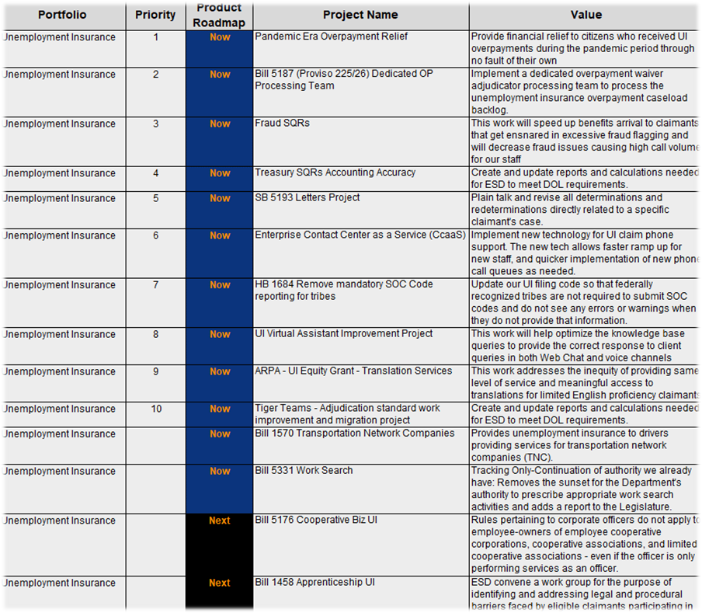
UI Portfolio
Prioritized
Product
Roadmap
As of June 2023

Slide 13
EAMS Project Closeout
Judy Dew, IT Tax & Wage Systems Manager

Slide 14
EAMS Legacy System Replacement
New features/customer facing benefits:
Provide near real time data between EAMS and NGTS
Automatic validation of bulk files
Added Standard Occupational Codes (SOC) HB 2308
Updated User Screens
Embedded a customer feedback link for Users
Updated new Payment screens
Added zero hour reasons

Slide 15
2022 Average Annual Wage & WBA
Matthew Klein, Operations Research Specialist, DATA, ESD

Slide 16
2022 Average Annual Wage & WBA
Per RCW 50.04.355 and 50.20.120, the minimum and maximum benefit levels, as well as the annual taxable wage base, are set each year based upon the average annual/weekly wage.
"the minimum amount payable weekly shall be 20 percent of the "average weekly wage" for the calendar year preceding [June 30, 2023]"
2022 Average Annual Wage: $84,167
2% increase over the 2021 average annual wage
Driven by a 5.5 percent increase in covered employment and a 7.6 percent increase in total earnings, which grew by nearly $20.3 billion in 2022.
The maximum weekly benefit amount for the period beginning July 2, 2023, is $1,019, while the minimum weekly benefit amount will be $323.

Slide 17
Overpayments Project Update
JR Richards, Unemployment Insurance Customer Support Director, ESD

Slide 18
Outreach campaign
GovDelivery Results:
115,163 individual emails sent
97% delivery rate
56% open rate
17% waiver link clicked
12% of population submitted waivers (@15,000)
Notification to claimants whose overpayments were relieved under blanket waiver
GovDelivery mailers regarding individual waiver requests
Physical mail sent to remaining population
Jan Feb March April May June July Aug Sept Oct Nov Dec
Claimant outreach/Public communication
Physical mail waiver sent to those who elected postal mail communications

Slide 19
Determining fault & equity and good conscience
Least clear
Most clear
Claimant #1
Told adjudicator during phone interview they were caring for a sick family member during the weeks they claimed, determined not able and available for work. Would have been eligible for PUA but didn't know to apply.
Claimant #2
Paused claiming for an extended period. When they resumed claiming, the claimant backdated the missed weeks and were paid conditionally. They later revealed they were incarcerated at the time. They did not understand they were not eligible and could not reach the department timely for assistance.
Claimant #3
Conditional approval was granted, pending the claimant providing additional documents required in order to make a claim determination. Claimant was contacted multiple times and never responded, claim was denied, and the weeks paid were owed back. Decision was upheld at OAH.
Claimant #4
High wage earner with no language or access barriers, claimed multiple weeks of benefits and answered on all weekly claims that they were not earning wages. Later revealed they were working and collecting. Benefits received were overpaid.

Slide 20
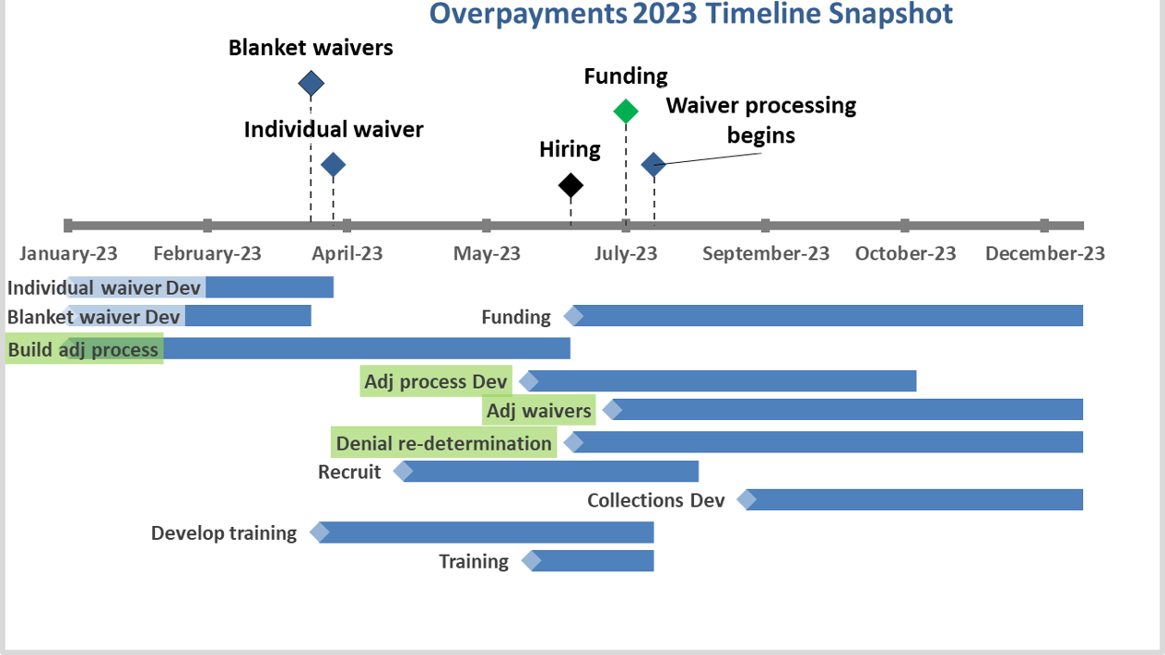

Slide 21
Meeting Cadence
JR Richards, Unemployment Insurance Customer Support Director, ESD

Slide 22
Proposed meeting cadence
Late July | June Trust Fund Report Legislative proposals Budget overview Rulemaking Update Updated taxable wage base | January | One-hour legislative session meeting Rulemaking Update
Late August / Early Sept | Legislative and budget submissions to OFM/Gov office: Likely committee action Minimum Weekly Benefit Amount report State Quality Service Plan Update Rulemaking Update | February | One-hour legislative session meeting Rulemaking Update
October / November | Trust Fund Report State Quality Service Plan Submission to USDOL Minimum Weekly Benefit Amount report Rulemaking Update Tax rate notices to employers | May | Legislative session wrap-up Rulemaking Update
December | Governor’s budget Trust Fund Report Legislative session prep Rulemaking Update | June | State Quality Service Plan update Work search report presentation Rulemaking Update

Slide 23
Future Meeting Topics
Legislative Session Updates
Rulemaking Updates
Overpayments Project Updates
Appeals Backlog Updates
Other?

