Slide 1
ASWS Advisory Committee
August 13, 2026

Slide 2
Equal opportunity statement
The Employment Security Department is an equal opportunity employer/ program. Auxiliary aids and services are available upon request to individuals with disabilities. We provide free help in many languages. People who need hearing or speech help can dial 711 for the Washington Relay.

Slide 3
Housekeeping
RECORDING ANNOUNCEMENT:
This meeting is being recorded. Please be advised that your image and voice will be captured and recorded during the videoconference. Your participation in this videoconference equals consent to be recorded.
ANUNCIO GRABADO:
Esta junta está siendo grabada. Por favor tenga en cuenta que su imagen y voz serán capturados y grabados durante la video-conferencia. Su participación en esta video-conferencia significa dar consentimiento de ser grabado.

Slide 4
Agenda

Slide 5
Committee Business
Meeting Minutes:
  July 23, 2026

Slide 6
Employment Security Organizational Changes
Joy Adams, Deputy Director, ESPI, ESD

Slide 7
ASWS Office updates
Bertha J. Clayton, Director, ASWS Office, ESD

Slide 8
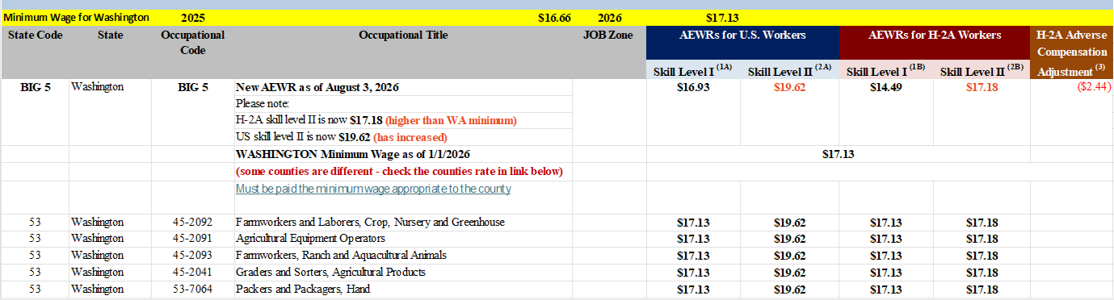
Federal Updates
August 3, 2026. Employment and Training Administration Publishes Federal Register Notice (FRN) Updating the H-2A Hourly Adverse Effect Wage Rates (AEWR) for All Non-Range Occupations

Slide 9
ASWS Office – Operations & Improvements
Enforcement agency coordination
Preparing ASWS staff for range housing inspections
End of season training with L&I, DOH, WSDA re: field check coordination inter-agency agreement
ASWS webpage
Transition planning for FFY 2027
Notes:
This slide shows the number of the applications and workers requested this program year by FLAG status.
The pie chart shows the number and percentage of applications this program year by FLAG status.

Slide 10
Discontinuation of Services
Discontinuation of Services – 20 CFR 658, Subpart F, initiated from October 1, 2025 – July 31, 2026 | 0

Slide 11
Processing and Adjudicating Foreign Labor Certification Applications
Petra Meraz, Supervisor, Foreign Labor Certification program, ASWS Office

Slide 12
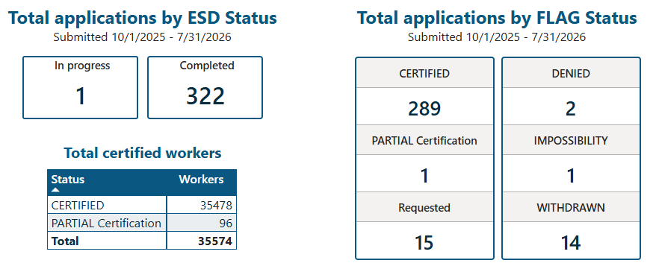
Summary status of applications and workers
October 1, 2025 – July 31, 2026
This table summarizes the number of applications and workers requested for the current program year, organized by their status within the Foreign Labor Application Gateway [FLAG].
Certified means that OFLC has approved the application to bring workers to Washington.
Requested means that an employer has applied to bring workers to Washington.
In progress means that the FLC team is reviewing the application.
Completed means that the FLC team completed our part of the application process.
Source: ASWS/ESD
Notes:
This slide shows the number of the applications and workers requested this program year by FLAG status.
The pie chart shows the number and percentage of applications this program year by FLAG status.

Slide 13
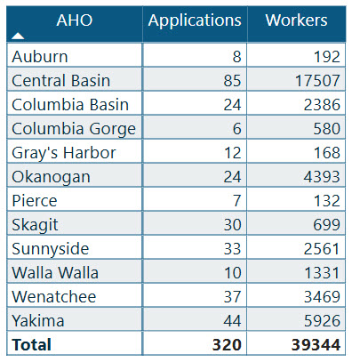
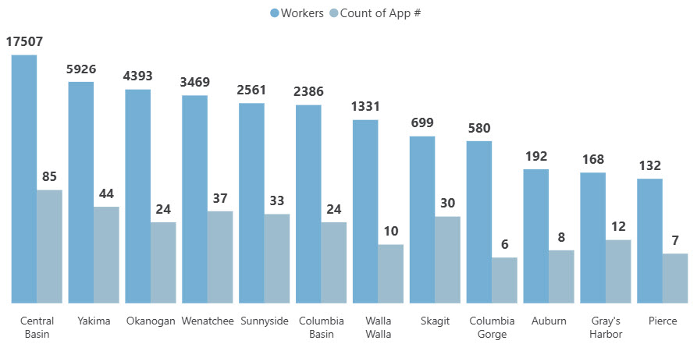
H-2A applications & workers requested by AHO
This shows the number of applications & the number of workers requested on those applications sorted by the Application Holding Office (AHO) for this program year, October 1, 2025, until the end of last month, July 31, 2026.
Source: ASWS/ESD
Notes:
This slide shows the number of the applications and workers requested this program year by FLAG status.
The pie chart shows the number and percentage of applications this program year by FLAG status.

Slide 14
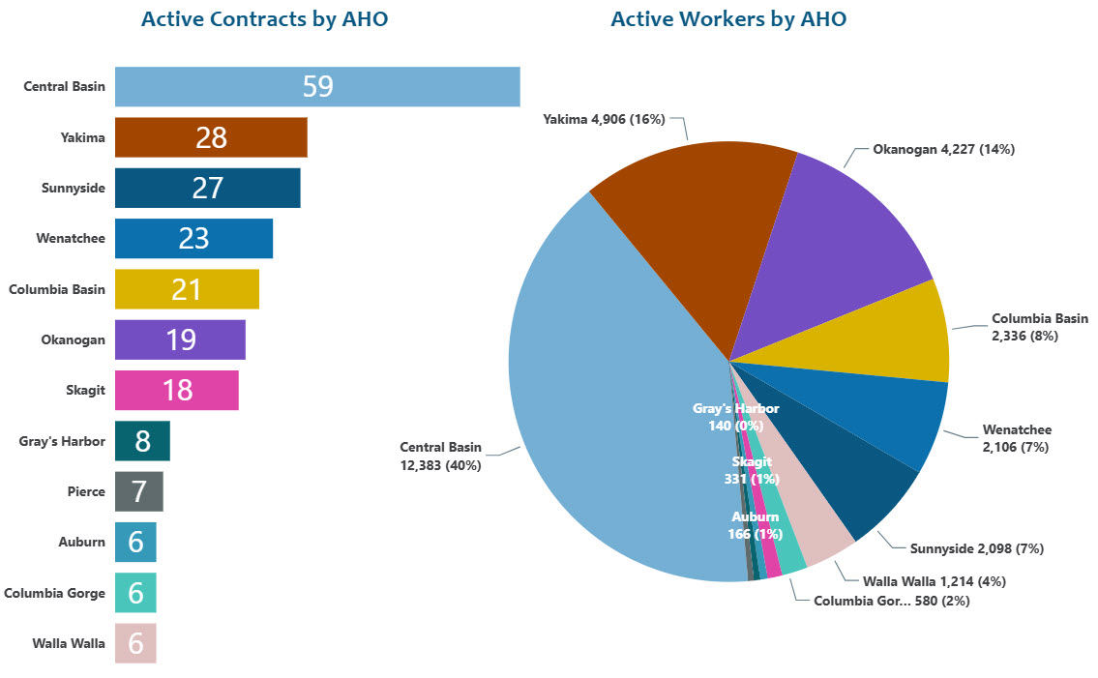
Number of active contracts & workers by AHO
Started by and ended after July 31, 2026
228
Contracts
30,619
Workers
Source: ASWS/ESD
Notes:
This slide shows the number of the applications and workers requested this program year by FLAG status.
The pie chart shows the number and percentage of applications this program year by FLAG status.

Slide 15
Completing Site Visits, (field visits) Field Checks and Complaint Resolution
Susana Rodriguez, Supervisor, Compliance Unit, ASWS Office

Slide 16
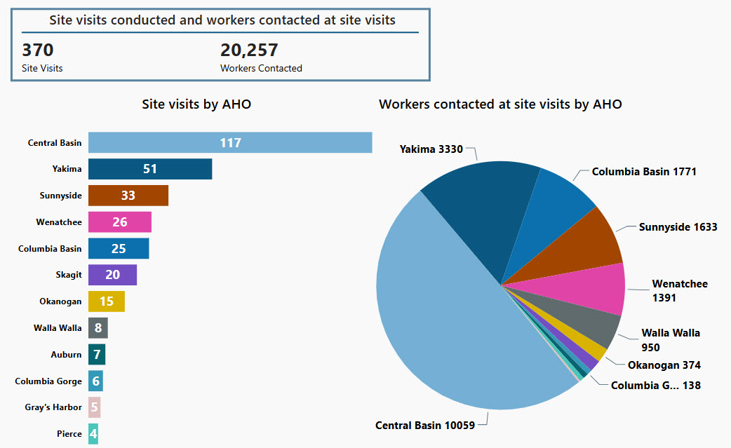
Site Visits
October 1, 2025 – July 31, 2026
Source: ASWS/ESD
Notes:
Slide for ASWS-AC

Slide 17
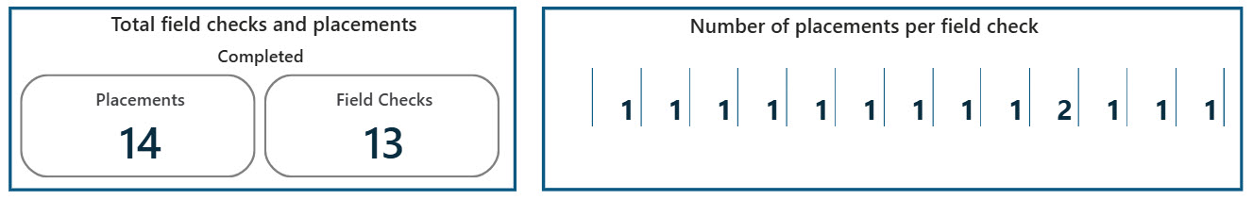
Field Checks
October 1, 2025 – July 31, 2026
Source: ASWS/ESD
Notes:
Slide for ASWS-AC

Slide 18
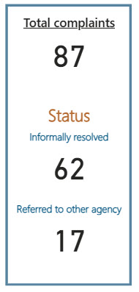
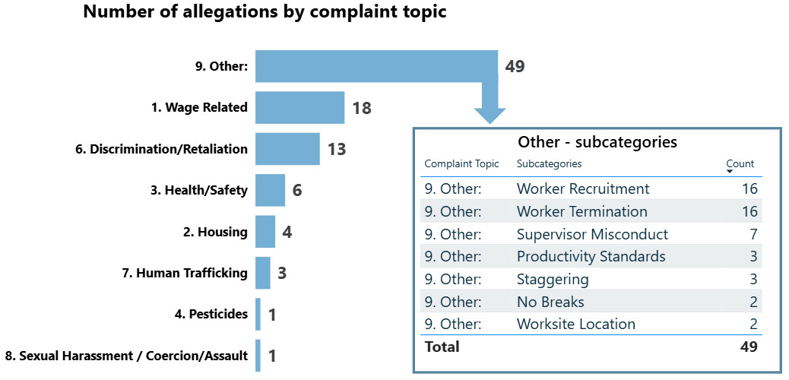
Complaints
October 1, 2025 – July 31, 2026
Source: ASWS/ESD
Notes:
Slide for ASWS-AC

Slide 19
Workforce Service Division
    Tim Probst, Employment Services Manager, ESD
    Jenna Argot, Agricultural Services Coordinator, ESD

Slide 20
MSFW Complaints and Apparent Violations
Workforce Services Division (WSD) Entering New PY26 (July 1, 2026, through July 31, 2026)
Total Number of Complaints | 8
Total Number of Apparent Violations | 2
Total Referred | 10
Total Resolved | 1

Slide 21
Complaint Type from MSFW’s
Workforce Services Division (WSD) Entering New PY26 (July 1, 2026, through July 31, 2026)
Health/Safety | 1
Discrimination | 0
Wage Related | 10
Other | 0

Slide 22
MSFW Outreach Performance
Workforce Services Division (WSD)
Program Year | 2024 (July1-June 30) | 2025 (July1-June 30)
Total FTEs* | 11 | 11
Total Outreach Days | 1,400 | 1,438
Total Number of MSFWs Contacted | 25,855 | 21,620
* There are six full-time outreach offices: Central Basin, Columbia Basin, Okanogan, Sunnyside, Wenatchee, and Yakima. The remaining offices conduct part-time outreach to MSFWs as part of their routine Wagner-Peyser responsibilities.

Slide 23
MSFWs Contacted by Full-time Outreach Offices

Slide 24
MSFWs Contacted by Part-Time Outreach Offices
* Columbia Gorge, Skagit, and Walla Walla changed from full-time outreach in PY24 to part-time outreach in PY25.

Slide 25
MSFWs Served by Region
July 2020 through June 4, 2026 (* PY25 Shows Partial Program Year)

Slide 26
MSFWs Served by Full-Time Outreach Offices

Slide 27
Total MSFWs Served Statewide
MSFWs served has increased by 251.1% from PY20 to PY25, despite unstable weather, international trade, and law enforcement variables.
3,071
* 2025-26 shows partial program year, through June 4, 2026

Slide 28
Highlights to Share
Clearance Order Training for Applicant Holding Offices
set for August 24th, 28th, and 31st

Slide 29
2026 ASWS Advisory Committee
Legislative report review
Bertha J. Clayton, Director, ASWS Office, ESD

Slide 30
Objective & timeline
Review:
July
Final Review:
July 23 – Aug 13
Report Approval:
Aug - Oct 31
Committee will have the opportunity to review the draft in July prior to the July 16th meeting.
Committee’s final review of the 2026 ASWS Report will be in the July 23rd Advisory meeting.
ESD internal reviews: Communications, Public Affairs, Commissioners & OFM. Report due to the Leg by Oct 31st, 2026.
Final committee edits due prior to the July 23rd Advisory meeting. ESD team will revise report draft.
Approval of the 2026 ASWS Report (Motion & 2nd) in the August 13th Advisory meeting

Slide 31
Report Approval
Sample Motion Language:
I move to approve the 2026 ASWS Legislative report draft as revised today.

Slide 32
Public Comment
PUBLIC COMMENT:
If you would like to make public comment, including any suggested future agenda items, please state your name and spell it so we can capture it correctly for the minutes, as well as the organization you represent if any. Your comments are being recorded. However, if you would like your comments to be included in the meeting minutes, please submit them in writing via email to Vickie Carlson at Vickie.Carlson@esd.wa.gov. Please limit your comments to two minutes.
COMENTARIO PUBLICO:
Si desea hacer un comentario público, incluyendo temas ó elementos de sugerencia para agendas futuras, por favor indique su nombre y deletréelo para poder capturarlo correctamente en los apuntes de la junta, también indique la organización a la que representa si hay alguna. Sus comentarios están siendo grabados. Sin embargo, si desea que sus comentarios sean incluidos en los apuntes de la junta, por favor envíelos por escrito por correo electrónico a Vickie Carlson a vickie.carlson@esd.wa.gov. Por favor limite sus comentarios a dos minutos.

Slide 33
Good of the Order
Future Agenda Items
Adjournment

Slide 34

Next ASWS Meeting: Thursday, July 16, 2026, from 9AM to 12pm
ASWS Advisory Committee Meeting
Thursday, September 17, 2026
9:00 a.m. – 12:00 a.m.
Zoom

