Slide 1
ASWS Advisory Committee
May 21, 2026

Slide 2
Equal opportunity statement
The Employment Security Department is an equal opportunity employer/ program. Auxiliary aids and services are available upon request to individuals with disabilities. We provide free help in many languages. People who need hearing or speech help can dial 711 for the Washington Relay.

Slide 3
Housekeeping
RECORDING ANNOUNCEMENT:
This meeting is being recorded. Please be advised that your image and voice will be captured and recorded during the videoconference. Your participation in this videoconference equals consent to be recorded.
ANUNCIO GRABADO:
Esta junta está siendo grabada. Por favor tenga en cuenta que su imagen y voz serán capturados y grabados durante la video-conferencia. Su participación en esta video-conferencia significa dar consentimiento de ser grabado.

Slide 4
Agenda

Slide 5
ASWS Office updates
Bertha J. Clayton, Director, ASWS Office, ESD

Slide 6
ASWS Office updates – Operations & Improvements
ASWS Webpage on esd.wa.gov
Technology in field work
Employer resources
Case management system expansion (CMS)
Staff training
Source: ASWS/ESD
Notes:
This slide shows the number of the applications and workers requested this program year by FLAG status.
The pie chart shows the number and percentage of applications this program year by FLAG status.

Slide 7
ASWS Office updates – Working together
Federal partner communication
State partner coordination
Intra-agency (ESD) coordination regarding recruitment, complaint processing
Source: ASWS/ESD
Notes:
This slide shows the number of the applications and workers requested this program year by FLAG status.
The pie chart shows the number and percentage of applications this program year by FLAG status.

Slide 8
ASWS Office updates – FLC Grant FY 2026
Foreign Labor Certification grant:
  FY 2026 allotment: $597,365.00 (-15.26%)
  FY 2025 allotment $704,973.00

Slide 9
Processing and Adjudicating Foreign Labor Certification Applications
Petra Meraz, Foreign Labor Certification Program Supervisor, ASWS Office

Slide 10
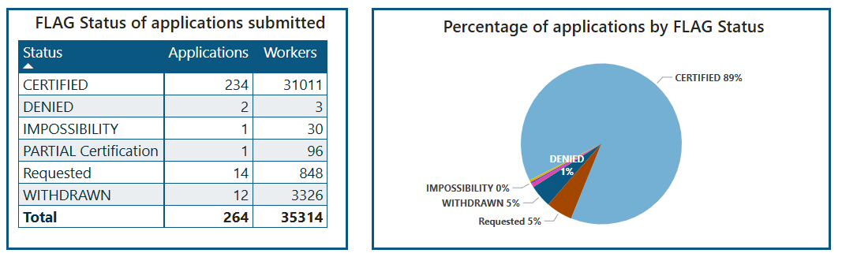
Summary status of applications and workers
October 1, 2025 – April 30, 2026
This table summarizes the number of applications and workers requested for the current program year, organized by their status within the Foreign Labor Application Gateway [FLAG]. The accompanying pie chart illustrates the percentage of applications by FLAG status.
Certified means that OFLC has approved the application to bring workers to Washington.
Requested means that an employer has applied to bring workers to Washington.
Source: ASWS/ESD
Notes:
This slide shows the number of the applications and workers requested this program year by FLAG status.
The pie chart shows the number and percentage of applications this program year by FLAG status.

Slide 11
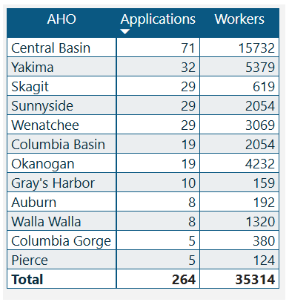
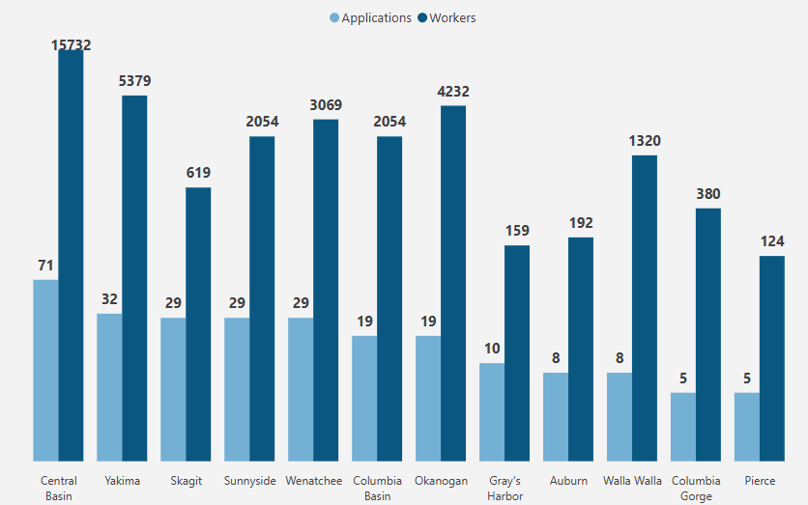
Number of H-2A applications & workers requested; by AHO
October 1, 2025 – April 30, 2026
This shows the number of applications & the number of workers requested on those applications sorted by the Application Holding Office (AHO) for this program year, October 1, 2025, until the end of last month. (4/30/2026)
Source: ASWS/ESD
Notes:
This slide shows the number of the applications and workers requested this program year by FLAG status.
The pie chart shows the number and percentage of applications this program year by FLAG status.

Slide 12
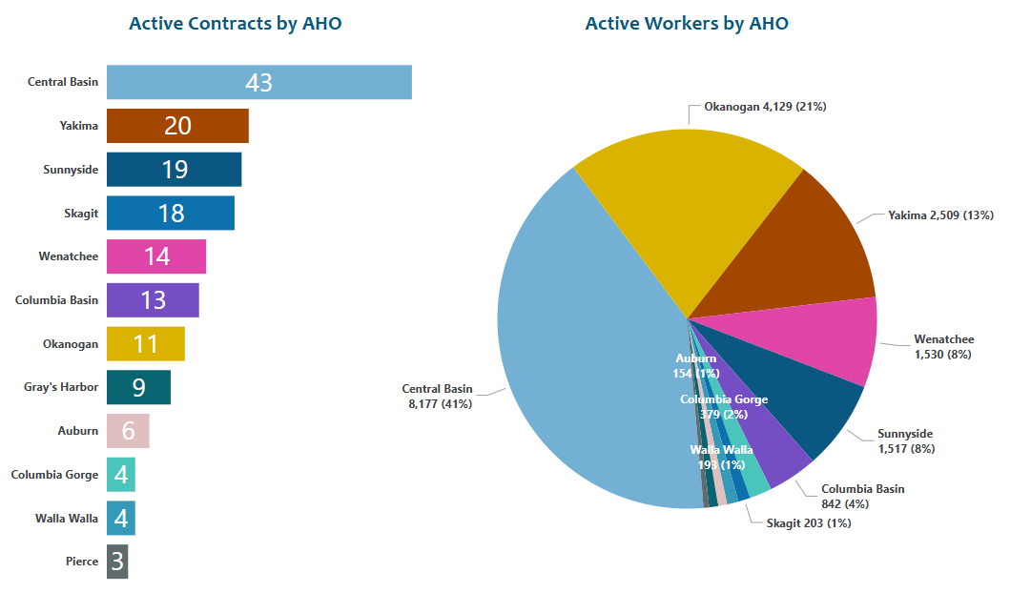
Number of active contracts & workers; by AHO
Started by and ended after April 30, 2026
164
Contracts
19,876
Workers
Source: ASWS/ESD
Notes:
This slide shows the number of the applications and workers requested this program year by FLAG status.
The pie chart shows the number and percentage of applications this program year by FLAG status.

Slide 13
Completing Site Visits, (field visits) Field Checks and Complaint Resolution
Susana Rodriguez, Compliance Unit Supervisor, ASWS Office

Slide 14
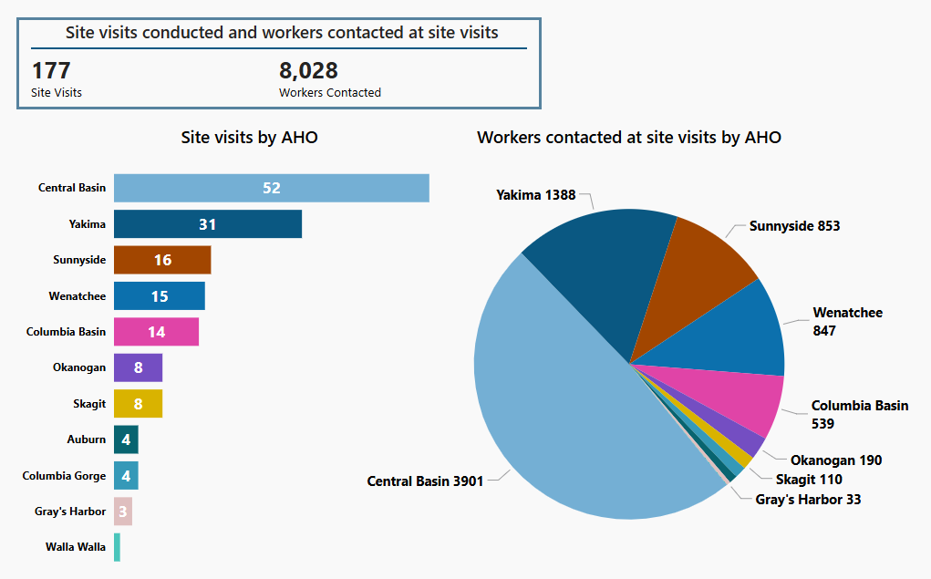
Site Visits
October 1, 2025 – April 30, 2026
Source: ASWS/ESD
Notes:
Slide for ASWS-AC

Slide 15
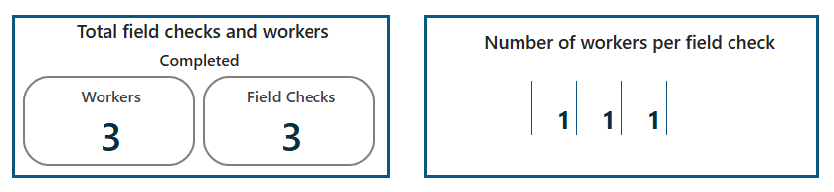
Field Checks
October 1, 2025 – April 30, 2026
Source: ASWS/ESD
Notes:
Slide for ASWS-AC

Slide 16
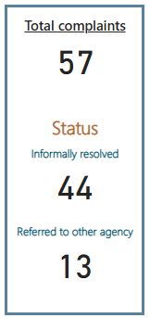
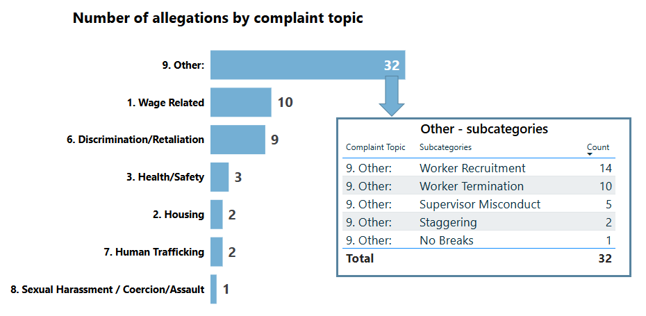
Complaints
October 1, 2025 – April 30, 2026
Source: ASWS/ESD
Notes:
Slide for ASWS-AC

Slide 17
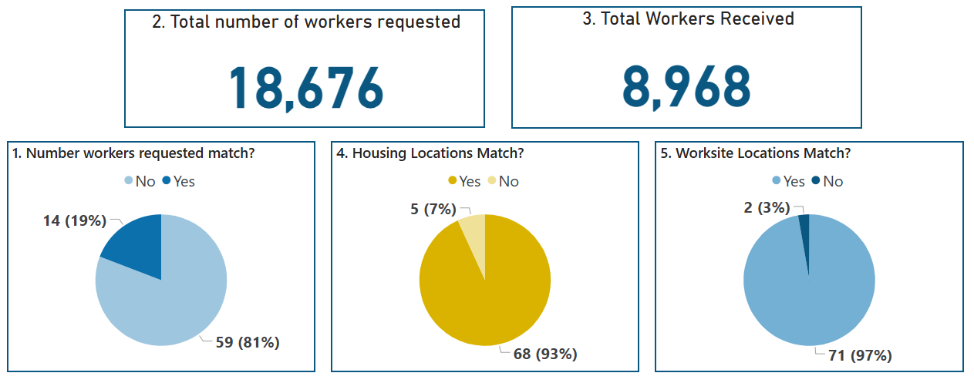
ASWS quarterly report – 2 Qtr. PY2026
January 1, – March 31, 2026
Source: ASWS/ESD
Notes:
Slide for ASWS-AC

Slide 18
Workforce Services Division (WSD)
Tim Probst, Employment Services Manager, WSD, ESD
Jenna Argot, Agricultural Services Coordinator, WSD, ESD
Michelle Griffith, Regional Operations Manager, WSD, ESD

Slide 19

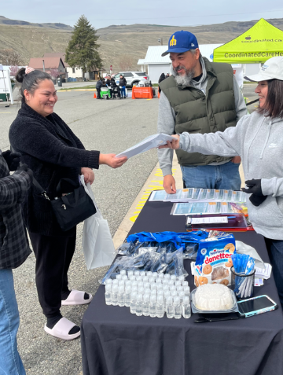
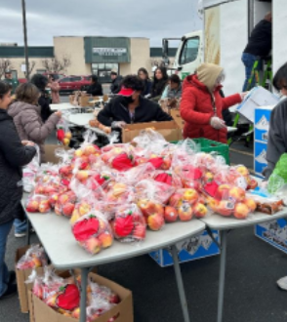
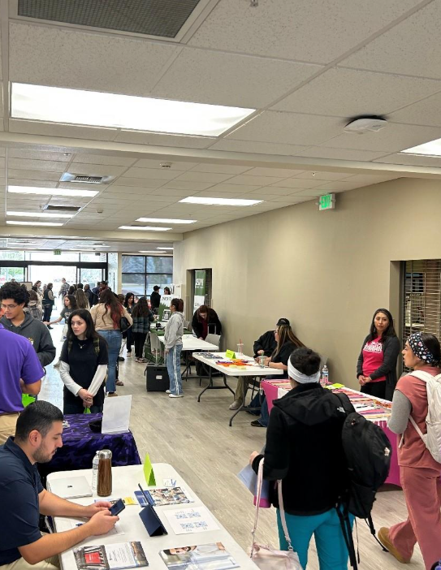
MSFW Outreach
December was a slow month for many offices.
Hoping to place January Photo here.
Notes:
Recall briefly our excellent conversations with Saul and Luis last meeting

Slide 20
MSFW Outreach Performance
Workforce Services Division (WSD)
Program Year | 2024 (July1-June 30) | 2025 (July1-April 30)
Total FTEs* | 11 | 11
Total Outreach Days | 1,400 | 1,180
Total Number of MSFWs Contacted | 25,855 | 17,011
* There are six full-time outreach offices: Central Basin, Columbia Basin, Okanogan, Sunnyside, Wenatchee, and Yakima. The remaining offices conduct part-time outreach to MSFWs as part of their routine Wagner-Peyser responsibilities.

Slide 21
MSFW Complaints and Apparent Violations
Workforce Services Division (WSD) July 1, 2025 through April 30, 2026
Total Number of Complaints | 102
Total Number of Apparent Violations | 4
Total Referred | 96
Total Resolved | 13

Slide 22
Allegation of Complaints from MSFW’s
Workforce Services Division (WSD) July 1, 2025 through April 30, 2026
Health/Safety | 9
Discrimination | 6
Wage Related | 93
Other | 4

Slide 23
MSFWs Contacted by Full-time Outreach Offices

Slide 24
MSFWs Served by Region
July 2023 through April 2026 (* 2025-26 Shows Partial Program Year)

Slide 25
MSFWs Served by Full Time Outreach Offices

Slide 26
Changes to Share
June 17-18 MSFW In-Person Summit
Thank you, LNI, for recent meetings and partnership

Slide 27
Updates to WorkSourceWA.com
Michelle Griffith, Regional Operations Manager, Workforce Services Division

Slide 28
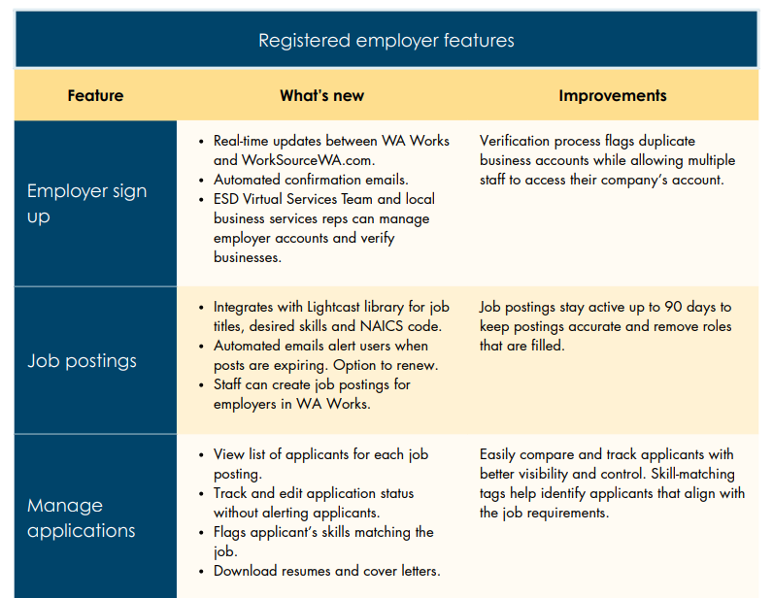
What’s changing: impacts and improvement
More information can be found here:
WorkSourceWA key changes
Notes:
A modern design with easier navigation.
Updated resources for employers.
Most features will be available right away and more will be added over time.
Important details:
All users with an active company account will move to the new site. An employer account is active if the company has posted a job in the last 5 years. If an account is not active on June 4 they will need to create a new account on the updated site

Slide 29
What to expect
ESD is committed to supporting both employer and job seekers through this transition
WorkSourceWA printable handout employer
WorkSourceWA
Direct Communication
Email campaign, website banners and alerts, ESD employer newsletter
Instructional content
How to save account information, logging in for the first time, the employer dashboard
Post go-live support
Dedicated professionals at WorkSource and via the Virtual Services Team
Notes:
Timeline:
Thursday, June 4 at 5 PM
• The current website goes offline.
• After 5 PM, the website and all accounts will be down.
• Visitors will see a message on the site that it is temporarily unavailable.
Tuesday, June 9 The new WorkSourceWA.com goes live.
Active Employer Accounts:
All users with an active company account will move to the new site. An employer account is active if the company has posted a job in the last 5 years. If an account is not active on June 4 they will need to create a new account on the updated site
Direct emails
We are sending weekly emails to all employers with existing WorkSourceWA accounts. These emails include details and reminders preparing them for the transition. We are copying you on each message so you can see what customers are receiving.

Slide 30
Agency updates
Joy Adams, Director, Employment System Policy & Integrity Division, ESD

Slide 31
Agency updates
Flood disaster relief:
  Disaster Unemployment Assistance
WIT launch: June 9, 2026
  In relation to Ag workers

Slide 32
Public Comment
PUBLIC COMMENT:
If you would like to make public comment, including any suggested future agenda items, please state your name and spell it so we can capture it correctly for the minutes, as well as the organization you represent if any. Your comments are being recorded. However, if you would like your comments to be included in the meeting minutes, please submit them in writing via email to Vickie Carlson at Vickie.Carlson@esd.wa.gov. Please limit your comments to two minutes.
COMENTARIO PUBLICO:
Si desea hacer un comentario público, incluyendo temas ó elementos de sugerencia para agendas futuras, por favor indique su nombre y deletréelo para poder capturarlo correctamente en los apuntes de la junta, también indique la organización a la que representa si hay alguna. Sus comentarios están siendo grabados. Sin embargo, si desea que sus comentarios sean incluidos en los apuntes de la junta, por favor envíelos por escrito por correo electrónico a Vickie Carlson a vickie.carlson@esd.wa.gov. Por favor limite sus comentarios a dos minutos.

Slide 33
Good of the Order
Summary of Meeting
Future Agenda Items
Adjournment

Slide 34

Next ASWS Meeting: Thursday, July 16, 2026, from 9AM to 12pm
ASWS Advisory Committee Meeting
Thursday, July 16, 2026
9:00 a.m. – 12:00 p.m.
Zoom

