Slide 1

ASWS Advisory Committee Meeting
Wednesday, November 20, 2024
1:00 p.m. – 3:00 p.m.

Slide 2
Housekeeping
RECORDING ANNOUNCEMENT:
This meeting is being recorded. Please be advised that your image and voice will be captured and recorded during the videoconference. Your participation in this videoconference equals consent to be recorded.
ANUNCIO GRABADO:
Esta junta está siendo grabada. Por favor tenga en cuenta que su imagen y voz serán capturados y grabados durante la video-conferencia. Su participación en esta video-conferencia significa dar consentimiento de ser grabado.

Slide 3
Agenda

Slide 4
ASWS Office Update - November 2024
Bertha J. Clayton, ASWS Director, ESD

Slide 5
Office Updates
Decision Package Endorsement
  WA Workforce Training & Educational Coordinating Board
Data Collection (HB 2226)
Recruitment update
  Compliance Supervisor
  State Monitor Advocate
Inter-agency Coordination
  IAA – Field Check Coordination
  TWH IAA – roles and responsibilities, housing verifications for subsequently listed housing, etc.
Education & Training
  2-day compliance training (10/17-10/18)
  Wafla Summit (Presenters) (11/21/24)
  National Council of Agricultural Employers (NCAE) (12/4-12/6)
  Discontinuation of Services process training & tools with AAG (12/2/24)

Slide 6
Processing and Adjudicating Foreign Labor Certification Applications
Petra Meraz, Foreign Labor Certification Program Supervisor, ASWS, ESD

Slide 7
Year to Date Comparison

Slide 8
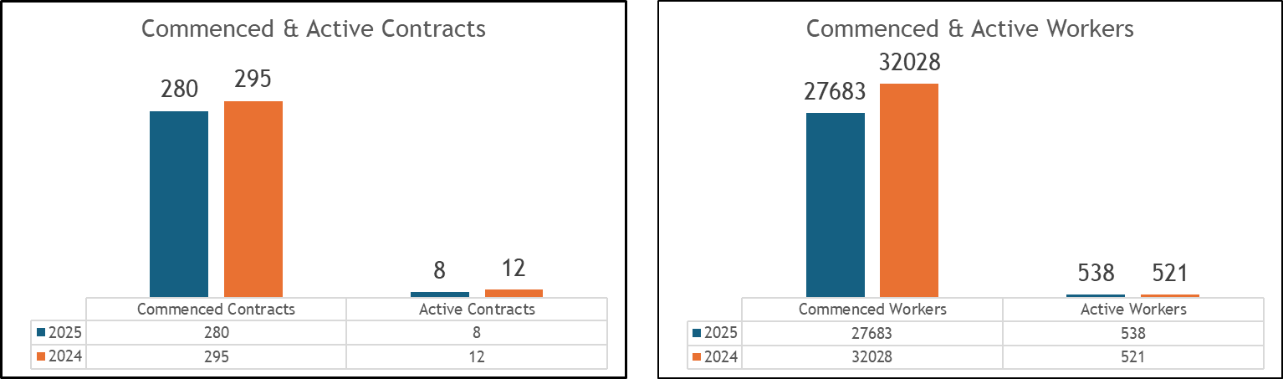
Commenced & Active YTD Comparison

Slide 9
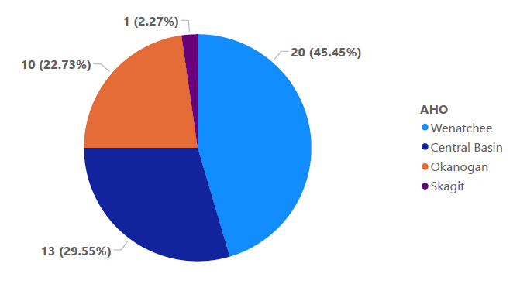
Workers requested by AHO

Slide 10
Completing site visits (field visits) and Field Checks
Carlos Sandoval-Larios, Temporary Compliance Team Supervisor, ASWS, ESD

Slide 11
Processing complaints consistent with 20 CFR 658, Subpart E Reporting Period: 10/1/24 – 10/31/24
3
1
1

Slide 12
Complaints / Apparent Violations Received Reporting Period: 10/1/24 – 10/31/24

Slide 13
Conducting Field Visits (Site Visits)
Reporting Period: 10/1/24 – 10/31/24
  Site Visits: The ASWS compliance team conducts site visits (aka field visits) to H-2A workers to inform workers of their rights and contract assurances under the H-2A regulations. Additionally, employers are provided with education regarding program requirements and given compliance resources and technical support.
Site Visit Goal: | 100% of job orders
Number of Site Visits Performed by ASWS Compliance Staff | 32
Approximate number of workers who attended Site Visits and received information | 1,708

Slide 14
Conducting Field Checks
Reporting Period: 10/1/24 – 10/31/24
20 CFR 653.503 Field Checks
  (a) If a worker is placed on a clearance order, the SWA must notify the employer in writing that the SWA, through its ES offices, and/or Federal staff, must conduct random, unannounced field checks to determine and document whether wages, hours, and working and housing conditions are being provided as specified in the clearance order.
  (c) Field checks must include visit(s) to the worksite at a time when workers are present. When conducting field checks, ES staff must consult both the employees and the employer to ensure compliance with the full terms and conditions of employment.
Number of Placements (seeker referred by ESD to job order and started working) | 6
Number of Field Checks Performed by ASWS | 2

Slide 15
Workforce Services - October 2024
Craig Carroll, Business Operations Manager, Workforce Services, ESD

Slide 16
MSFW Outreach Performance
Workforce Services Division (WSD) July through October Outreach Performance Data
 | 2023 | 2024
Total FTEs | 11 | 11
Total Outreach Days | 582 | 567
Total Number of MSFWs Contacted | 12,220 | 13,036

Slide 17
Highlights of Outreach to Farmworkers
WorkSource Columbia Gorge
Direct support to MSFW facing discrimination
Outreach Staff assisted MSFW with an Apparent Violation.
  Employer denied transportation to MSFW for medical needs.
  Employer refused to pay the 75% contract wages required under the job order.
  Employer failed to provide light duty work.
Outreach Staff connected MSFW to appropriate resources, enforcement agencies, and community partners.
Result: Apparent violation was resolved and MSFW was rehired.
WorkSource Wenatchee Valley
Repeat customer referrals to Clearance Orders
1:1 customer-centric service has led to repeat customers.
Elias referred to Clearance Order
MSFW struggled to find and keep employment for longer than a 2-week period.
Outreach Staff introduced MSFW directly to foreman, exchanged contact information.
Result: MSFW completed contract. Foreman followed up to share that MSFW was hired to remain for year-round work.
Migrant Couple referred to Clearance Order
Seasonal workers from California arrived seeking Ag. work
Outreach Staff led MSFWs to locate worksite.
Outreach Staff introduced MSFWs to employer
Result: Employer hired, conducted interview and safety assessment while onsite.
WorkSource Mason County
Expanded outreach to farmworkers
Staff conducting outreach to farmworkers in Mason Count partnered with CIELO, a CBO serving the Latino community.
Result: Connected with 75 MSFWs who were interested in job and training opportunities, and referred two farmworkers to long term, non-agricultural job openings.

Slide 18
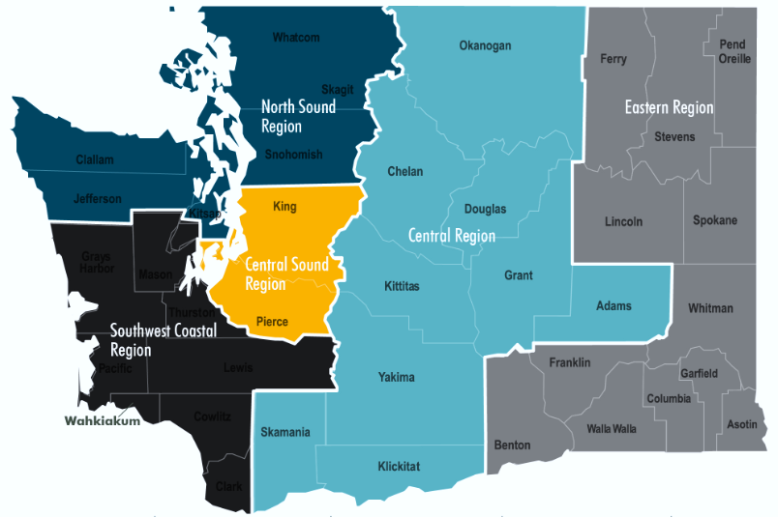
Agricultural Employment Map
Crop Production “Covered” Employment • 2022 (Covered employment excludes H-2A workers)
 | North Sound | 5,755
 | Central Sound | 1,999
 | Southwest Coastal | 1,896
 | Central | 32,780
 | Eastern | 7,513
*Source: esd.wa.gov/labormarketinfo/ag-employment-and-wages

Slide 19
MSFWs Served by Region • Rolling 12 Months
November through October

Slide 20
MSFWs Served by Significant Office
Rolling 12 Months
November through October

Slide 21
MSFWs Served by Region • Migrant vs Seasonal
Rolling 12 Months
November 2023 through October 2024

Slide 22
MSFWs Served by Significant Office • Migrant vs Seasonal
Rolling 12 Months
November 2023 through October 2024

Slide 23
Services Provided To MSFWs
Top 5 Services November 2023 through October 2024
1. | Translation/Interpretation Services
2. | Provided WorkForce Information
3. | RESEA (Reemployment Services)
4. | Meaningful UI Assistance
5. | Deskside Job Seeker Assistance

Slide 24
Job Order Referral Data
October 1, 2023 through September 30, 2024

Slide 25
Improvements to the Referral Process
Process Improvement Project • Collaborative Effort between ASWS and WSD
▶ Gap
Referrals are made outside of ETO/WSWA.com system
We are recording referrals in 2 different systems
Follow-up on referrals is conducted differently in offices
Communication between WSD and ASWS is inconsistent
Notifying employers about referrals is not part of our current process
Placement verification is not reliable
▶ New Process
Recording all referrals in ETO
Referring staff send email at time of referral to employer and FLC
Follow up and record outcome within 3 days of referral in ETO
Notify ASWS Compliance when applicants offered a job
ASWS Compliance verifies placement with employer when contract starts
ASWS Compliance notifies AHO and staff update record with placement in ETO

Slide 26
Customer Experience Study Wrap-Up
Olga Kondratjeva, Program Evaluation, Research and Analysis Manager, LMIR Division, ESD

Slide 27
Policy Updates
Joy Adams, ESPI Policy Director, ESD

Slide 28
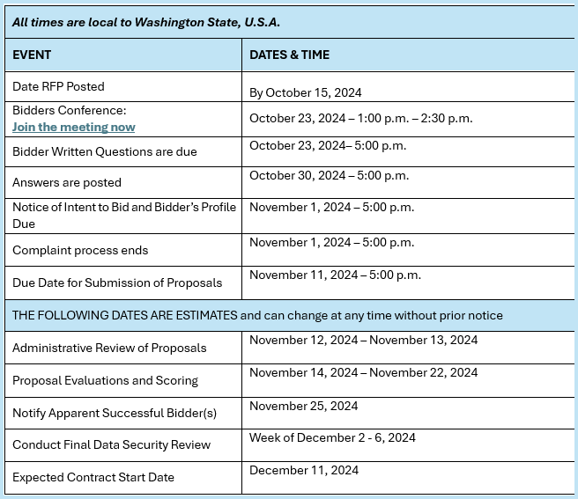
HB2226 Sec. 2 update
We are at the 9th step in the schedule (Proposal Evaluations and Scoring)
Notes:
Our evaluators are expected to review and score each vendors bid by Friday November 22nd, 2024, after which a successful bidder for the RFP will be chosen and notified the following Monday (November 25th, 2024). Once a bidder has been chosen, we will begin drafting a contract to fulfill the work outlined in RCW 50.38.070.
The timeline for completing that work will be contingent upon the successful bidder's ability to execute the stipulations within the contract, so unfortunately, I do not have a solid timeline for completing the work until we know who will be receiving the bid and what the contents of the executed contract will be.

Slide 29
Wage replacement workgroup report

Slide 30
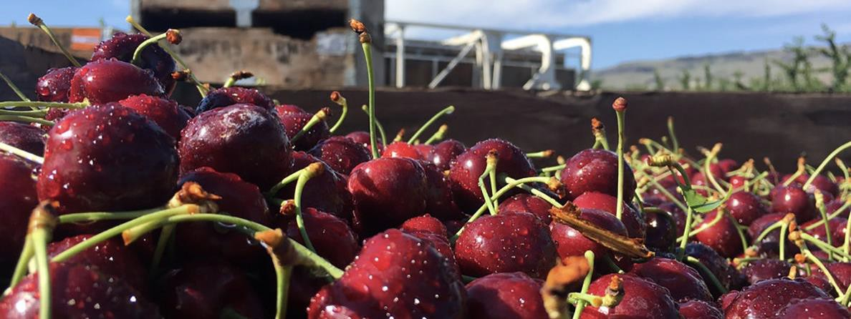

IMPROVING CHERRY HARVEST TENT CAMPS IN WASHINGTON STATE.

Slide 31
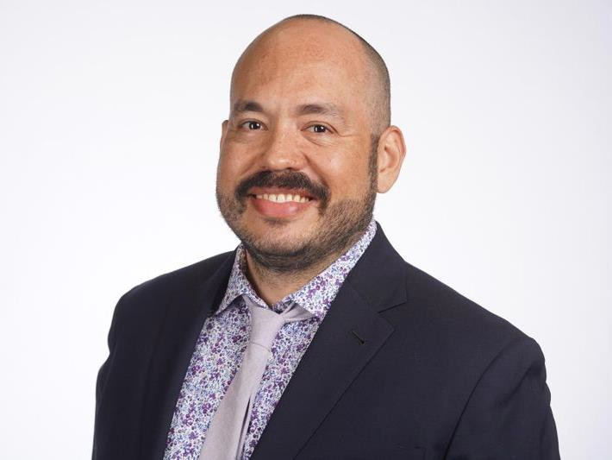
Improving Cherry Harvest Tent Camps
DOH and ASWS Committee meeting
November 20, 2024
Juan C. Gamez Briceno
Section Manager in OEHS
Temporary Worker Housing Program, Transient Accommodations Program, Schools EHS+IAQ Program, Clandestine Drug Labs Program, and Legionella Response.

Slide 32
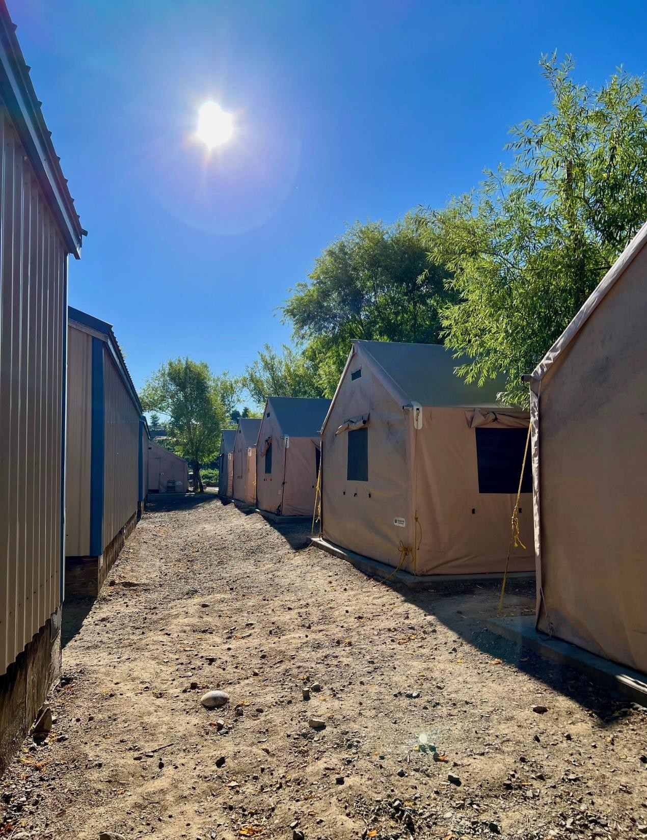
Improving Cherry Harvest Tent Camps:
What are cherry harvest camps?
History of the tents
Current resource for tents

Slide 33
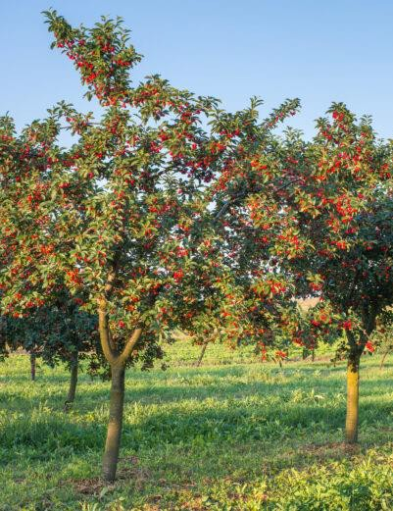
Improving Cherry Harvest Tent Camps
Aims of the project:
Spotlight and raise awareness in worker safety and health, climate change effects, labor conditions, and food security.
Why different rules for cherry harvest tent camps is an equity issue.

Slide 34
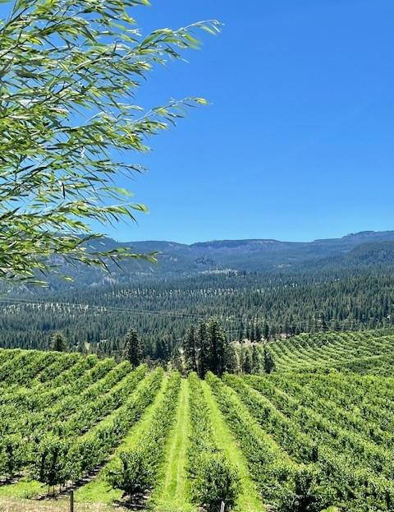
Improving Cherry Harvest Tent Camps
Aims of the project:
Equality
Equity and farmworkers
Why equity matters in agriculture.

Slide 35
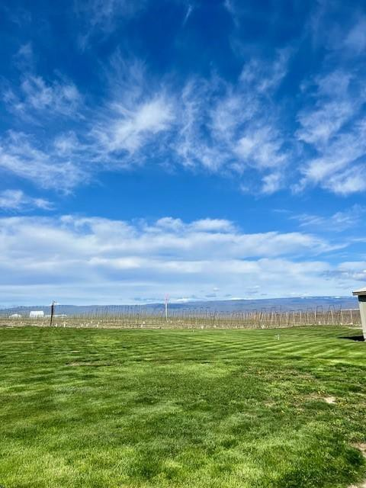
Improving Cherry Harvest Tent Camps: Local context
Cherry harvest season
U.S. Top producer of sweet cherries
States exporting cherries
Workforce

Slide 36
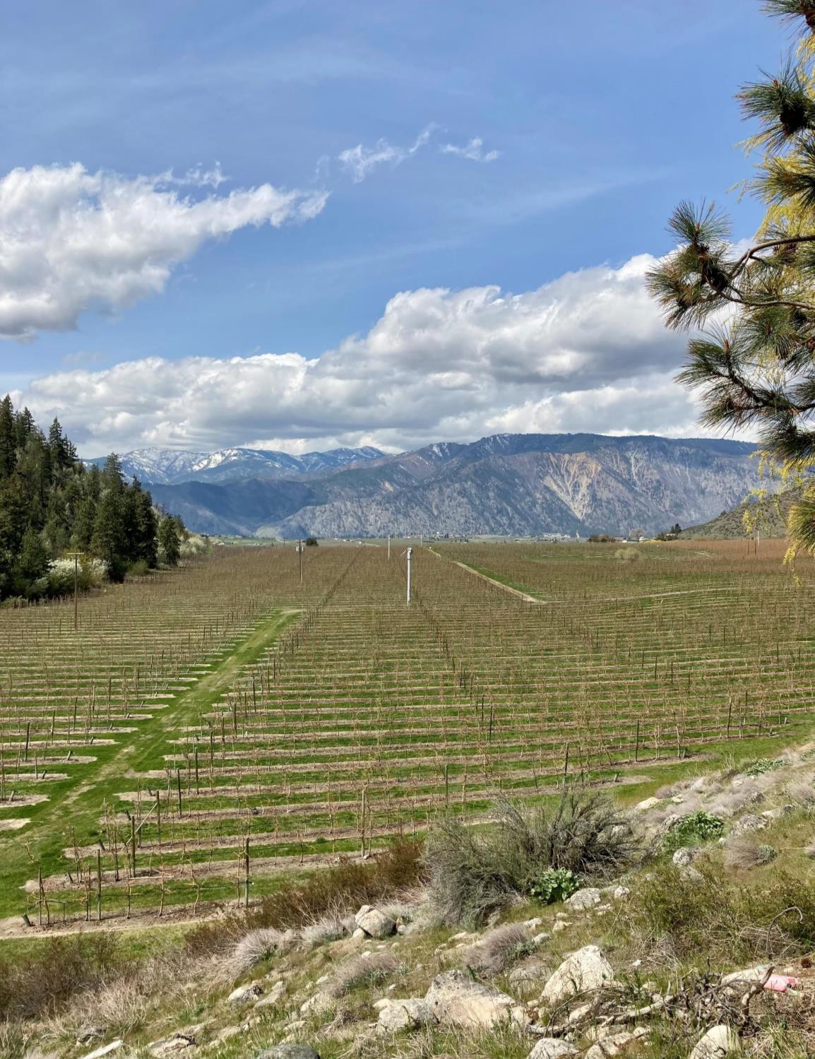
Improving Cherry Harvest Tent Camps: Local context
Currently licensed cherry harvest camps
University of Washington Climate Impact Group
Are cherry harvest seasons affected by climate change in Washington state?

Slide 37
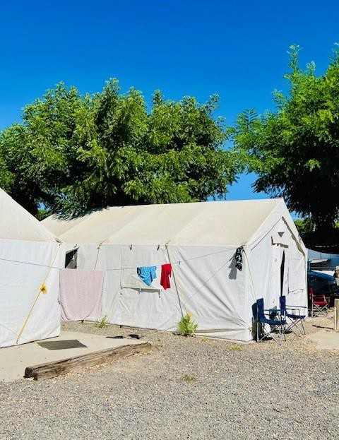
Improving Cherry Harvest Camps- Key issues facing farmworkers in cherry harvest tent camps in the state:
Heat-Related Risks
Wildfire Smoke Exposure
Lack of Protections
Increased Pesticide Use
Demand for Change

Slide 38
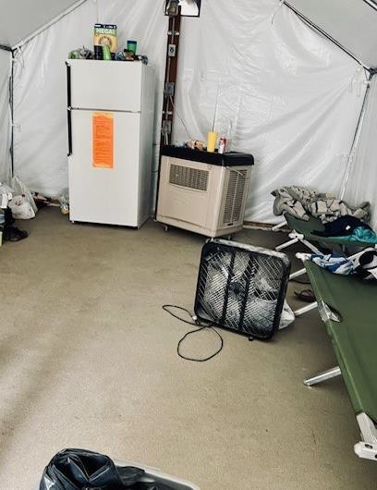
Improving Cherry Harvest Tent Camps: National Context
Cherry harvest in the state when compared with the rest of the country
Increasing number of workers
Production
Shortage of Farmworker Housing

Slide 39
Improving Cherry Harvest Tent Camps
Between 1992 and 2016, 285 construction workers died from heat exposure—accounting for more than 30% of heat- related occupational deaths
25% of Washingtonians – over 900,00 people – work in ‘heat- exposed’ sectors - transportation and warehousing, utilities, manufacturing, agriculture, mining, and construction
Agricultural workers die of heat-related illnesses at 20 times the rate of other civilian workers in the United States
Washington State Department of Health | 10

Slide 40
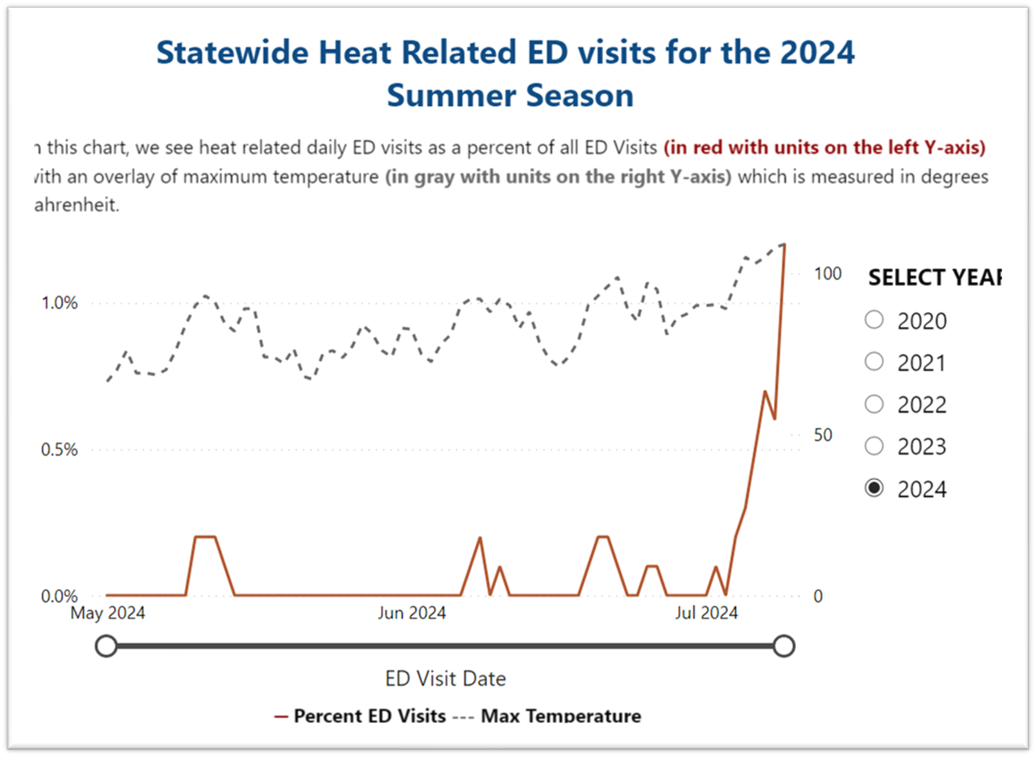
Seasonal Hazards Dashboards | Washington State Department of Health
Washington State Department of Health | 11

Slide 41
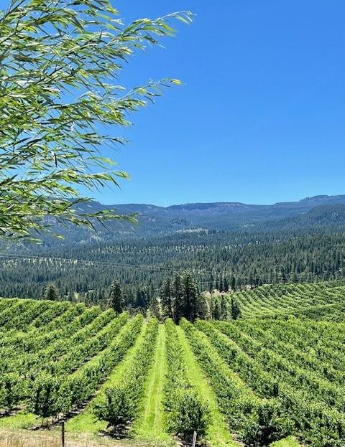
Improving Cherry Harvest Tent Camps: Conclusion
Personal statement
Recommendations
Acknowledgements

Slide 42
Questions?

Slide 43


To request this document in another format, call 1-800-525-0127. Deaf or hard of hearing customers, please call 711 (Washington Relay) or email civil.rights@doh.wa.gov.

Slide 44
On Break until 2:00 p.m.

Slide 45
Good of the Order
Future Agenda Items
Public Comment

Slide 46
Public Comment
PUBLIC COMMENT:
If you would like to make public comment, including any suggested future agenda items, please state your name and spell it so we can capture it correctly for the minutes, as well as the organization you represent if any. Your comments are being recorded. However, if you would like your comments to be included in the meeting minutes, please submit them in writing via email to Vickie Carlson at Vickie.Carlson@esd.wa.gov. Please limit your comments to two minutes.
COMENTARIO PUBLICO:
Si desea hacer un cometario público, incluyendo temas ó elementos de segurencia para agendas futuras, por favor indique su nombre y deletréelo para poder capturarlo correctamente en los apuntes de la junta, también indique la organización a la que representa si hay alguna. Sus comentarios estan siendo grabados. Sin embargo, si desea que sus comentarios sean incluidos en los apuntes de la junta, por favor envielos por escrito por correo electrónico a Vickie Carlson a vickie.carlson@esd.wa.gov. Por favor limite sus comentarios a dos minutos.

Slide 47
ASWS Advisory Committee Meeting
Wednesday, January 15, 2025
1:00 p.m. – 3:00 p.m.
Zoom

