Slide 1
Talking to your Legislators
Lobbying and testifying

Slide 2
Legislators are People just like us!
Washington Legislators work part-time, and most have other jobs for the rest of the year
Although considered ‘part-time’ many devote the majority of the year to legislative issues or campaigns
Many have the same concerns as you do, as they live in our communities and experiences are similar
Our legislators want to hear from you. If they don’t they don’t know what your concerns are.

Slide 3
How to find contact information
Go to Leg.wa.gov –
Click on “Legislators”
Search by name or committee, or enter your Legislative District
Click on “Find your legislative District” to find the legislators who represent you

Slide 4
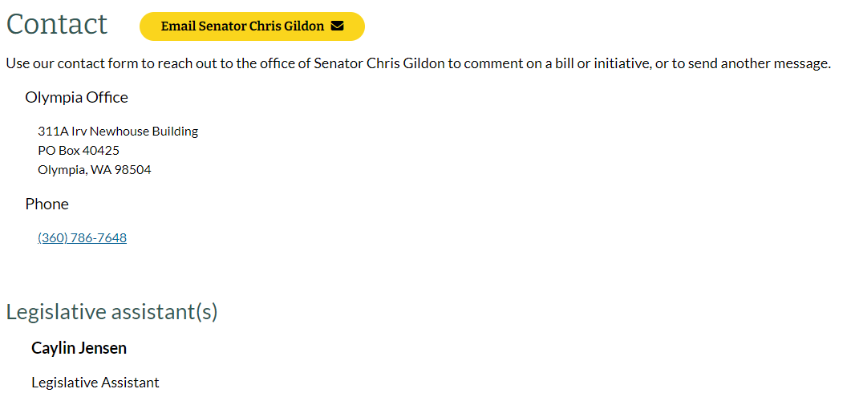
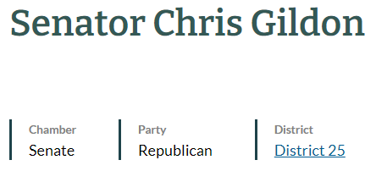
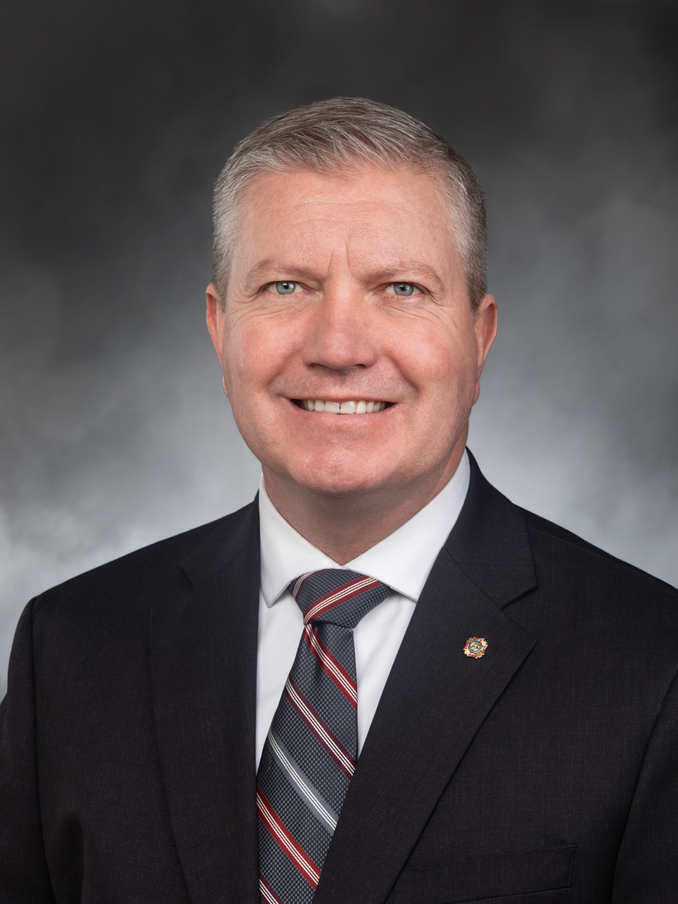

Slide 5
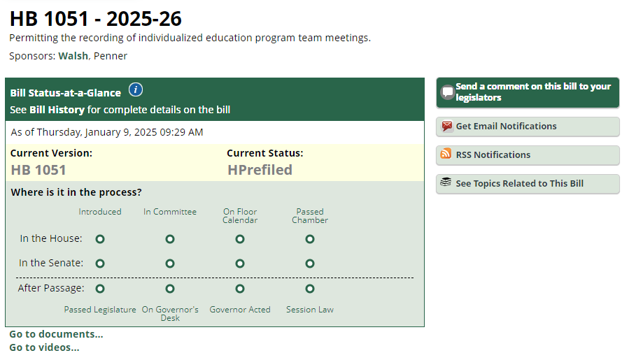

Slide 6
About your contact with legislators:
Keep communications simple, concise and to the point
Do your homework
Build rapport and establish a relationship
Focus on impact
Identify stakeholders’ values and key issues
Prepare to tell your story

Slide 7
Telling your story
Crafting and telling your story can help you make an emotional connection. Your legislator will be more likely to remember you and how you made them feel.
Make simple and specific statements
Avoid jargon and acronyms
Stick to the facts
Never stretch the truth or you will lose credibility
Prepare two to three points you wish to convey
Use AABT Formula:
And - connect points of your story
And - Prompts you to add more details
But - conveys the challenge or roadblock you need to overcome
Therefore - Tells how you plan to overcome the problem, and your desired result

Slide 8
Maintain Your Relationships:
Visit their local office, and at the capital
Connect with their staffers
Communicate throughout the year
Invite them to local events and programs
Give them fact sheets about your issue(s)

